Slide 1
La Finanza sostenibile in svizzera
Alberto Stival, Director PR & Communication

Slide 2

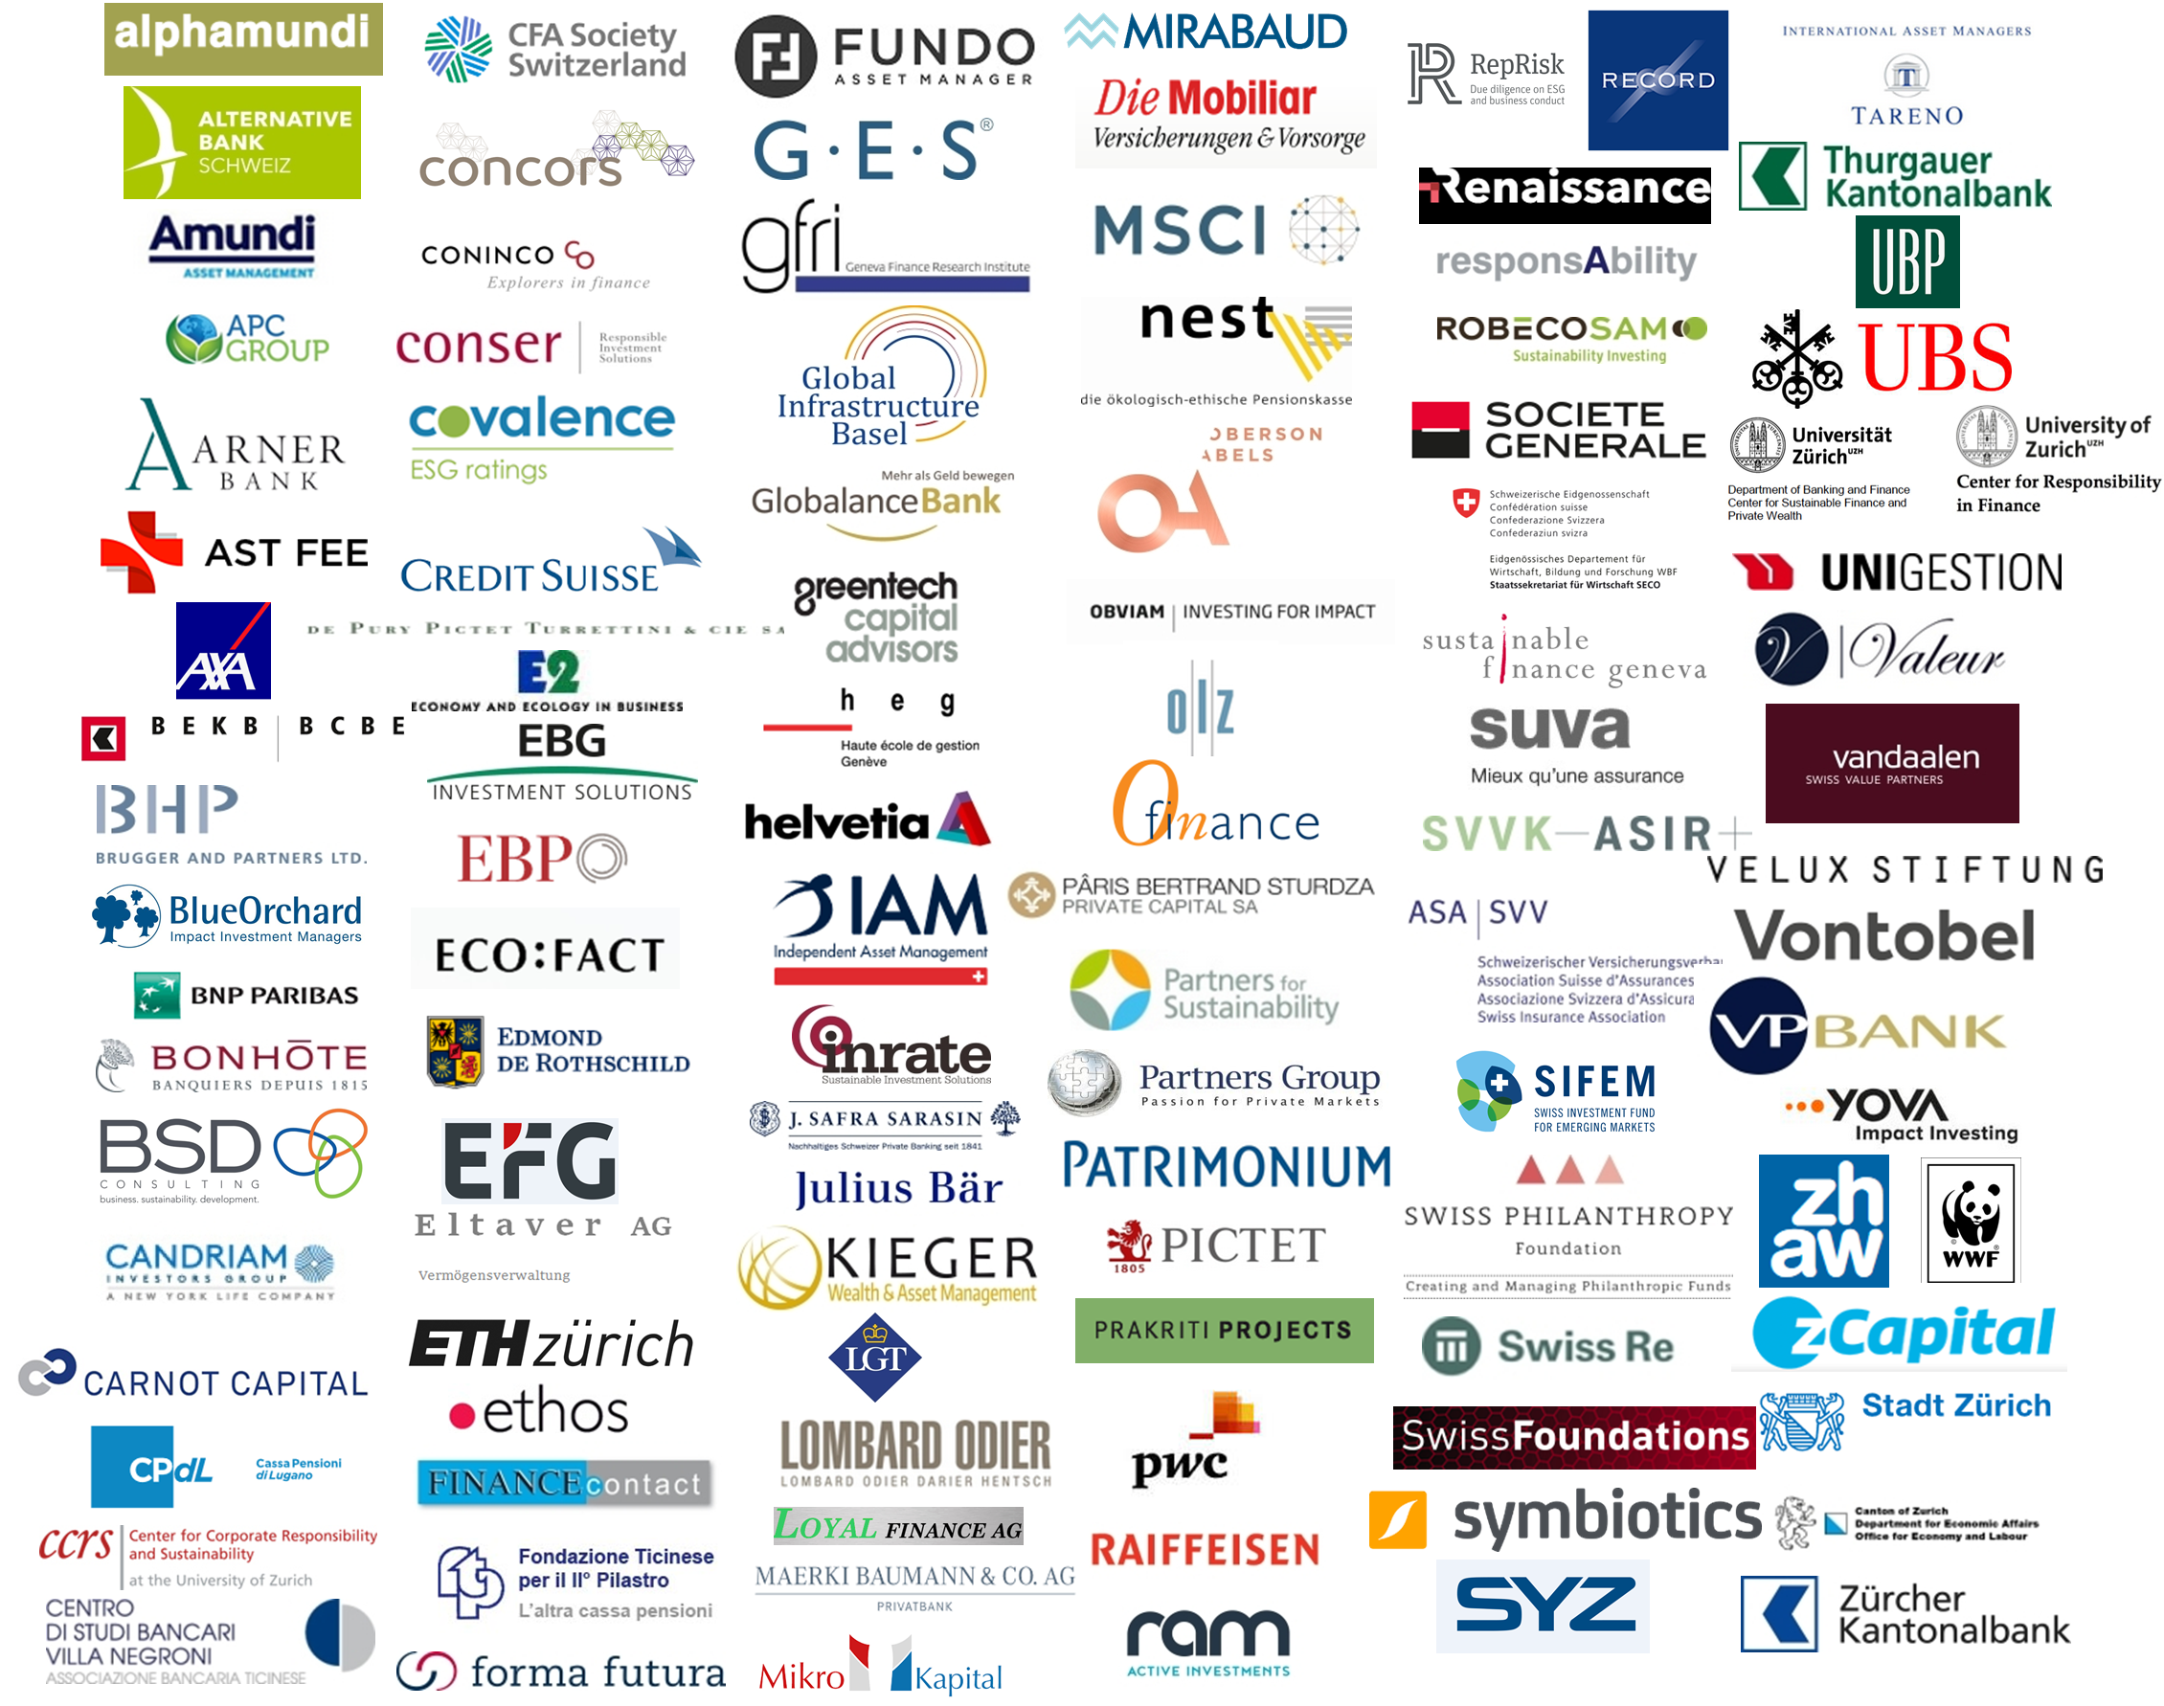
Swiss sustainable finance (SSF): Vision und Mission
  Swiss Sustainable Finance (SSF) rafforza la posizione della Svizzera come mercato globale della finanza sostenibile attraverso l'informazione, la formazione e la promozione della crescita.
  L'organizzazione, fondata nel 2014, ha rappresentanze a Zurigo, Ginevra e Lugano.
  Attualmente SSF riunisce oltre 150 membri e partner di rete, tra cui fornitori di servizi finanziari, investitori, università e scuole superiori, uffici pubblici e altre organizzazioni.

Slide 3
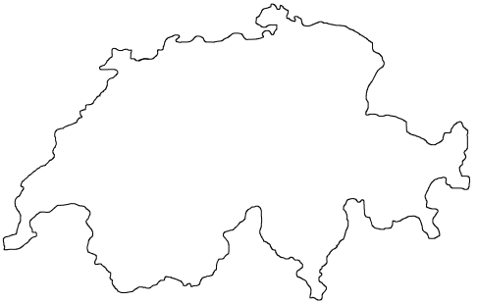
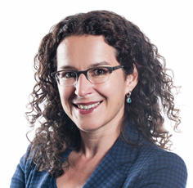
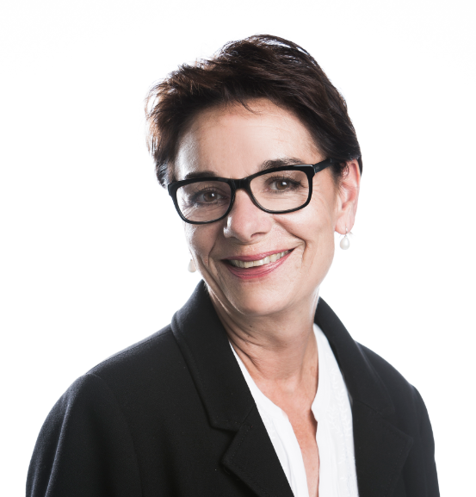
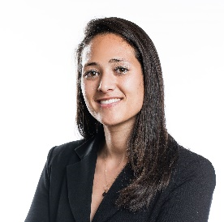
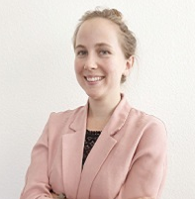
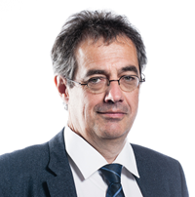
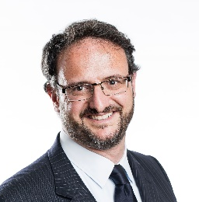
SSF Team
Anchored in three regions
Head office in Zurich
Sabine Döbeli
CEO
Marietta Caprez
Office Management
Representation in Geneva
Jean Laville Deputy CEO
Anja Bodenmann
Project Manager
Kelly Hess
Director Projects
Representation in Lugano
Alberto Stival
Director PR & Communication

Slide 4

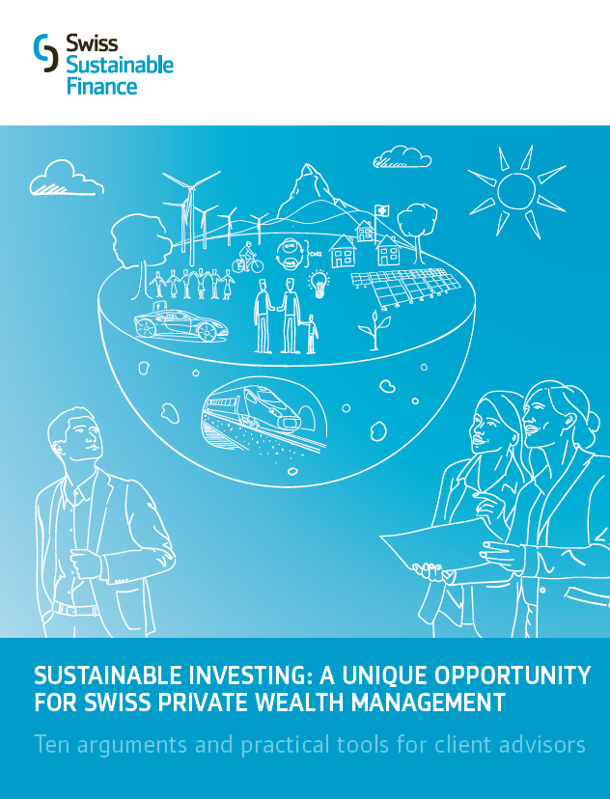
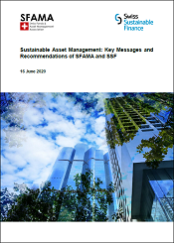
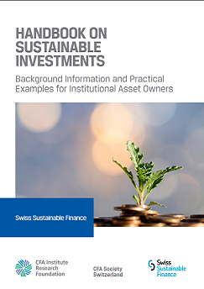

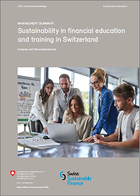
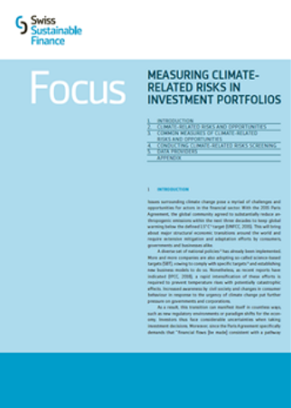
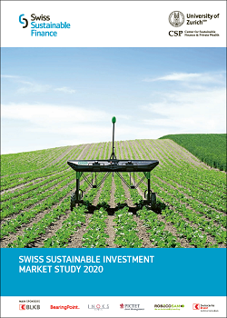
SOME SSF publications
Sustainable Asset Management: Key Messages and Recommendations of SFAMA and SSF
Handbook on Sustainable Investments (DE, FR)
SI as unique oppor-tunity for Swiss private wealth management
Handbook on Sustainable Investments (EN)
Swiss Sustainable Investment Market Study 2018
Sustainability in financial education and training in Switzerland (with FOEN)
Focus: Measuring Climate-related Risks in Investment Portfolios
Swiss Sustainable Investment Market Study 2020

Slide 5
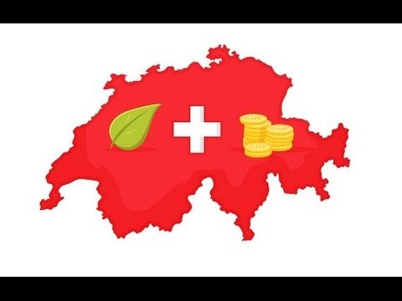
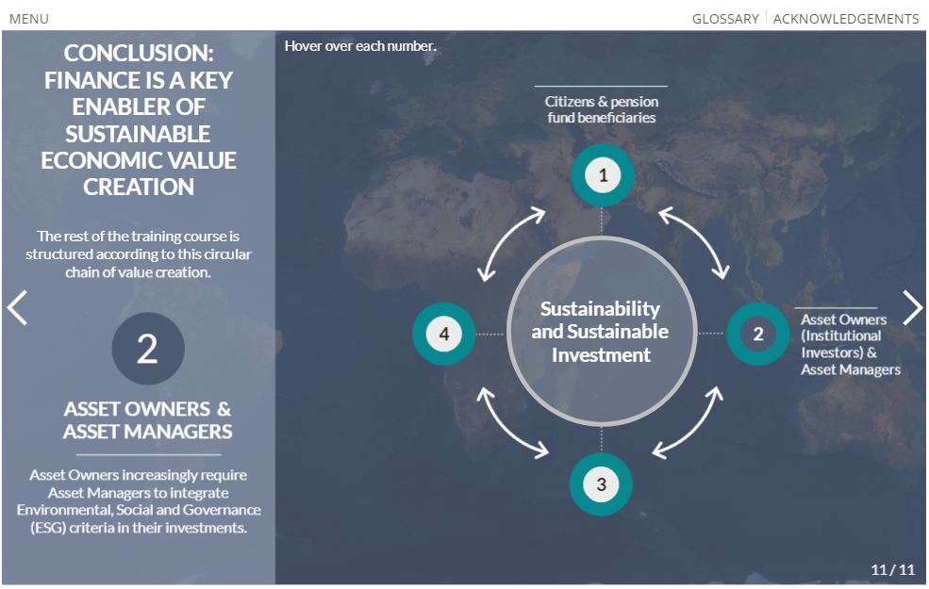
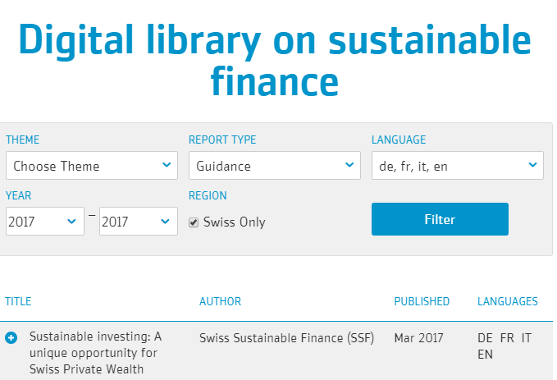
Some Other SSF projects
Film: Sustainable Investing, a unique opportunity for Swiss private wealth management
Education tools for financial professionals
Digital Library on Sustainable Finance
Arguments and tools for client advisors
https://www.youtube.com/watch?v=3coBFy9EPBk&t=
Education slide deck and online e-learning module
Online database of >300 publications in DE,EN,FR,IT

Slide 6
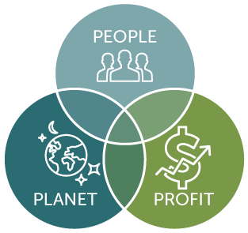
Definizione di finanza sostenibile
  „La finanza sostenibile si pone l‘obiettivo di creare valore nel lungo periodo, indirizzando i capitali verso attività che non solo generino un plusvalore economico, ma in modo che siano al contempo utili alla società e non superiono le capacità di carico del sistema ambientale.“
  Una gestione patrimoniale cosiddetta „sostenibile“ include considerazioni di natura ambientale, sociale e di governance.

Slide 7
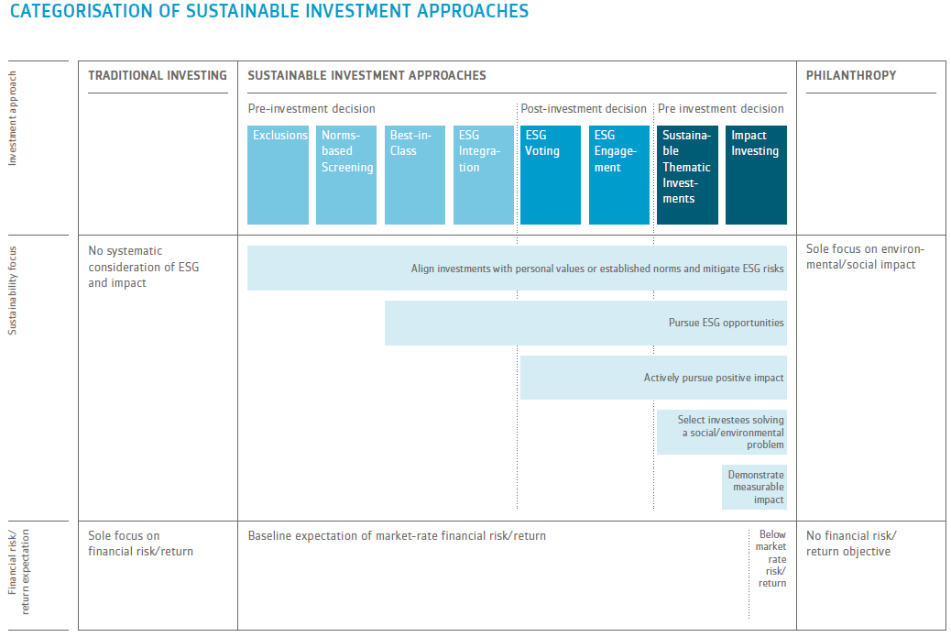
Investimenti sostenibili: Diversi approcci

Slide 8

Motivazioni per la finanza sostenibile
Domanda in aumento
  Clientela privata (HNWI, millennials, donne, …)
  Clientela istituzionale (Casse pensioni, assicurazioni, fondazioni, …)
Offerta in aumento
  Asset managers
  Service and information providers (ad es. società di rating sostenibile)
Pressione in aumento
  Società civile (politica, giovani, …)
  Accordi a livello internazionale
  (vedi l‘accordo di Parigi sul clima e i
  17 obiettivi per lo sviluppo sostenibile
  delle Nationi Unite)
  Intensificazione delle regole/leggi

Slide 9
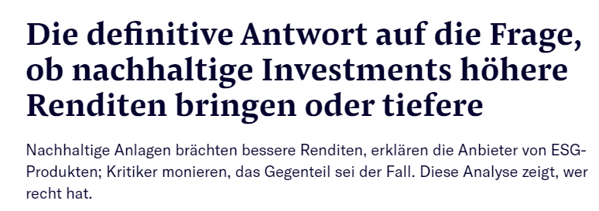
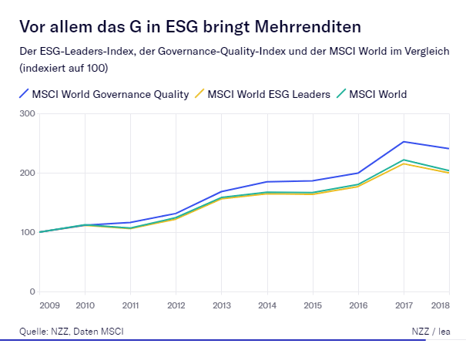



Impatto sulle performance: tra mito e realtà

Slide 10
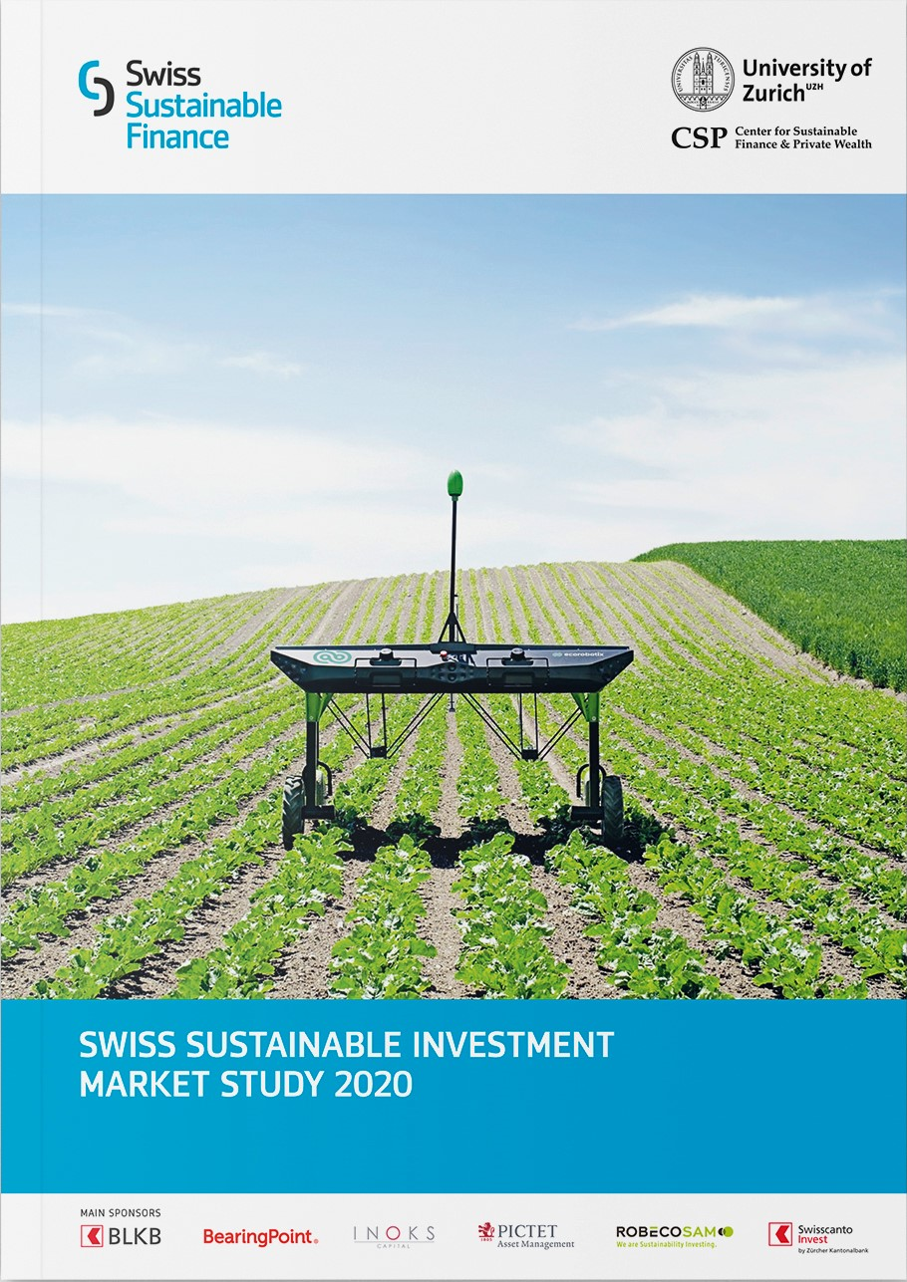










Swiss sustainable Investment Market Study 2020
Main sponsors
Supporting sponsors

Slide 11
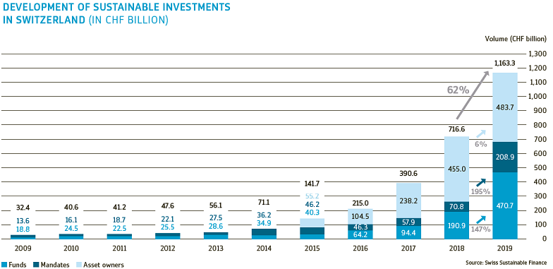
Growth Of sustainable investments continues

Slide 12
Sustainable investments now mainstream
Particularly high share of sustainable funds
  Sustainable funds now account for 38% of total fund market (18 % in 2018, 9% in 2017)
  Sustainable assets managed by institutional asset owners account for 30% of their total assets
  (31 % in 2018, 16 % in 2017)
  Total sustainable assets (funds, mandates, asset owner assets) correspond to about 1/3 of all assets managed in Switzerland¹
1 CHF 1,163.3 billion divided by CHF 3.34 trillion total assets managed in CH (SBA Banking Barometer 2019)

Slide 13
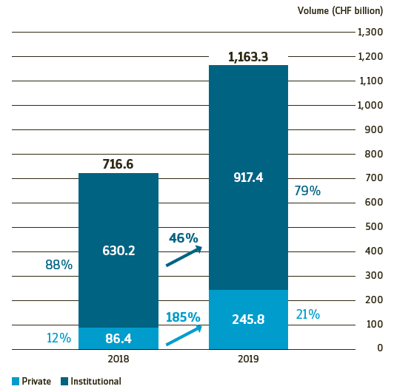
Private Investors gain Shares
Development of institutional and private sustainable investments
Notes:
Key facts:
Institutional investors still hold majority of all SI assets in Switzerland
Beginning to see more private SI volumes, now accounting for over 20% of the SI market

Slide 14
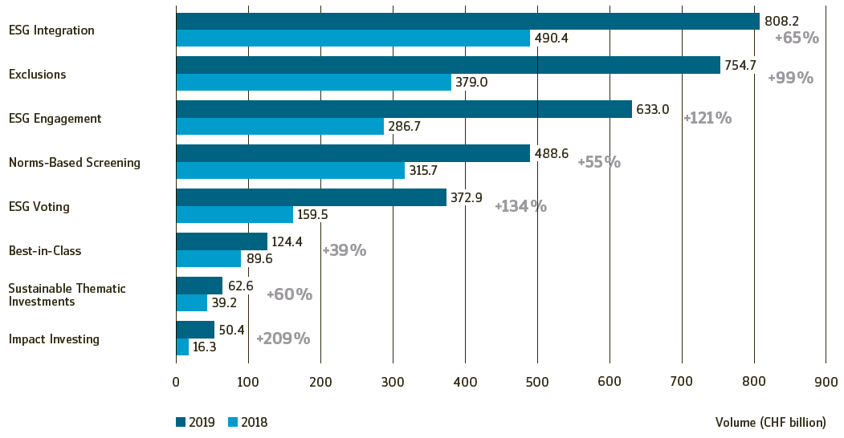
Active ownership and Impact gaining traction
Development of individual SI approaches
Notes:
Key facts:
ESG integration still most applied approach over all SI volumes
Outcome-oriented approaches showing relatively large growth rates

Slide 15
Lack of standards as key barrier for AM
Financial concerns still prominent for AO
Asset Managers
Asset Owners
Key
Client demand and legislative pressure
Board and Political pressure
Key Drivers
Lack of standards
Financial concerns
( performance & costs)
Key Barriers
Notes:
Demand from both institutional and private investors still important drivers
But legislative pressure is perceived as more important
Lack of conviction of client client advisors no longer major barrier
Lack of standards now top
Legislative had highest increase in importance: from 3.5 – 4.0

Slide 16
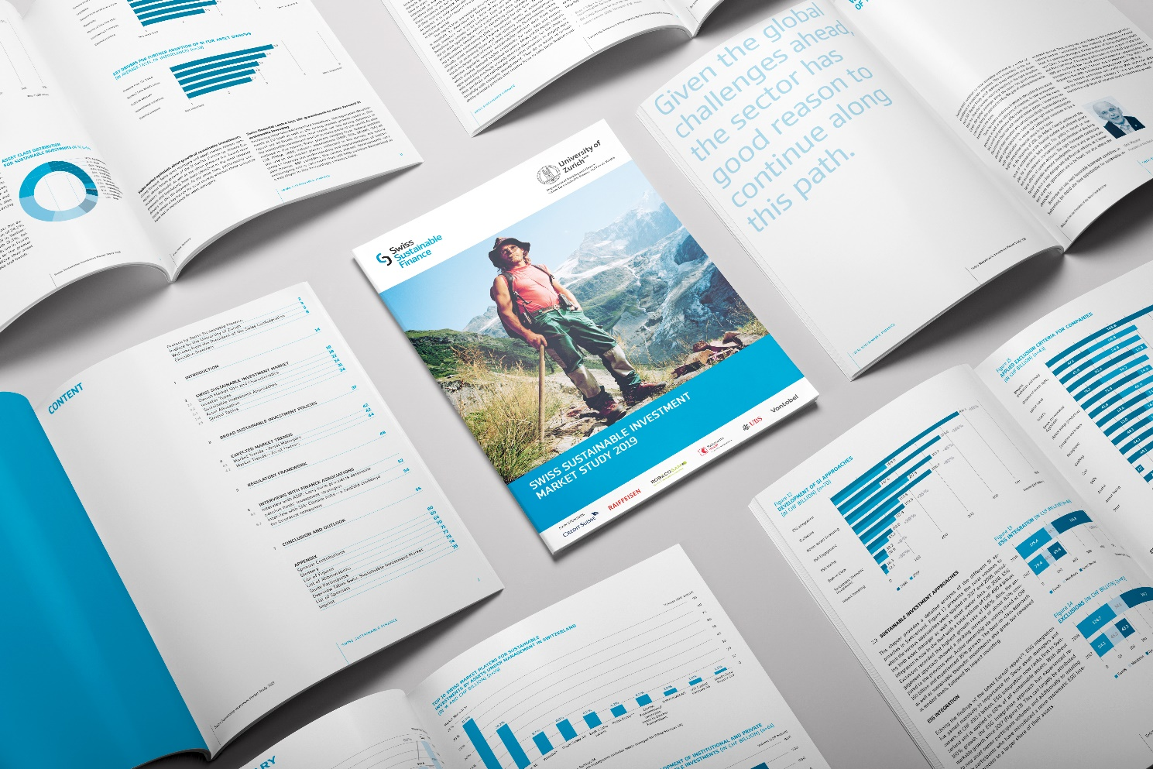
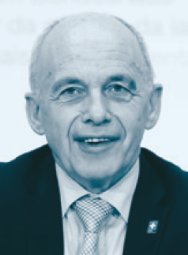
Perspective of President of the Swiss confederation, Ueli Maurer
“Sustainability presents a great opportunity – both in its own right and in combination with digitalization – to ensure that Switzerland continues to be a highly competitive financial centre in the future.”
Ueli Maurer
President of the Swiss Confederation

Slide 17
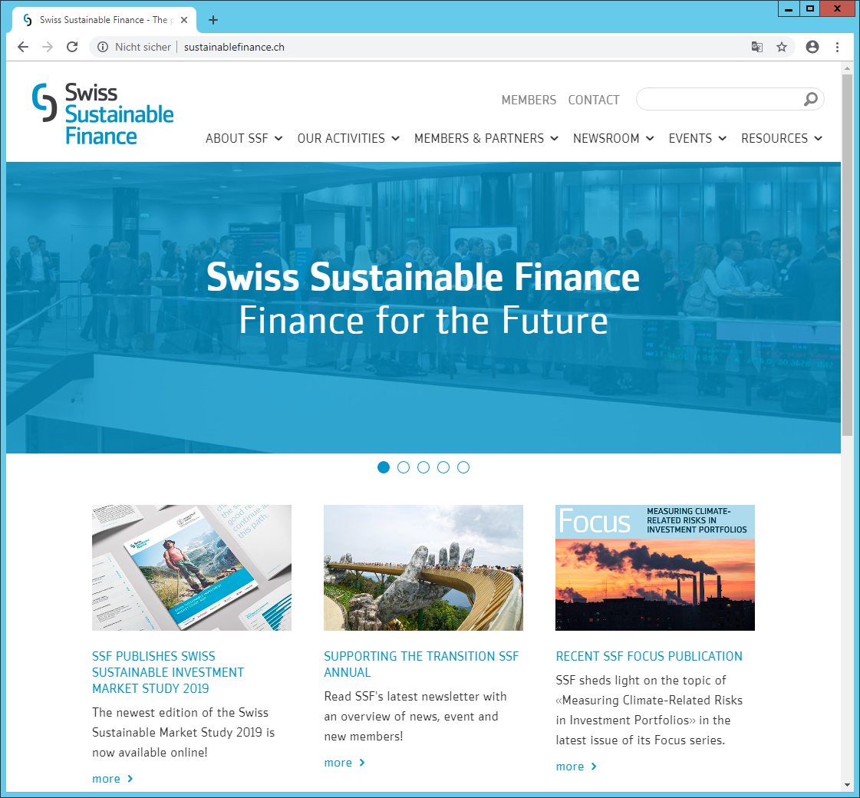
Contact

